Slide 1
Project 1 Group 2
A snapshot of overseas migration and housing prices
in Australia
between June 2013 - December 2021
by
Fabiano Santos
Lewis Trenerry
Simone Nagel
Liwei Jiang

Slide 2
Structure of the presentation
Introduction: questions, sample and data
Data preparation/cleasing
Findings as supported by table(s) and data visualisations
Summary and limitation(s)
* the maps may be presented here as highlights and support to the findings?

Slide 3
Questions
Based on the migration data, what is the highest and lowest states/territories impacted by the net migration between 2013-2021?
Based on the housing data, what was the highest and lowest states/territories impacted by housing price between 2013-2021?
Is there a correlation between net overseas migration and housing prices?

Slide 4
Prepare Data and Data Cleasing
Data sources:
Australian Bureau of Statistics[Australian Bureau of Statistics (abs.gov.au)]
Data period: Jun 2013 – Dec 2021
Data Cleasing:

Slide 5
Distribution of final data for analyses
State/territory | # of Quarters Net migration | Capital city | # of Quarters Housing price index
NSW | 35 | Sydney | 35
VIC | 35 | Melbourne | 35
QLD | 35 | Brisbane | 35
WA | 35 | Perth | 35
SA | 35 | Adelaide | 35
TAS | 35 | Hobart | 35
NT | 35 | Darwin | 35
ACT | 35 | Canberra | 35

Slide 6
Key findings
Q1: the highest and lowest states/territories impacted by the net migration between 2013-2021?
 | States | Average | Median | Variance | Standard Deviation | Max | Min | Net Migration (2013-2021) ('000)
0 | NSW | 67.32 | 72.84 | 1058.30 | 32.53 | 105.50 | -15.38 | 2356.35
1 | VIC | 57.03 | 64.19 | 1709.32 | 41.34 | 91.29 | -52.99 | 1996.02
2 | QLD | 23.50 | 27.74 | 206.33 | 14.36 | 41.83 | -15.19 | 822.49
3 | WA | 14.88 | 13.44 | 103.75 | 10.19 | 42.14 | -5.43 | 520.77
4 | SA | 10.72 | 11.99 | 26.40 | 5.14 | 18.03 | -3.26 | 375.28
5 | TAS | 2.08 | 1.82 | 1.10 | 1.05 | 4.00 | -0.32 | 72.65
6 | NT | 1.33 | 1.14 | 1.10 | 1.05 | 4.35 | -0.50 | 46.45
7 | ACT | 2.51 | 3.21 | 4.30 | 2.07 | 4.60 | -3.15 | 87.75

Slide 7
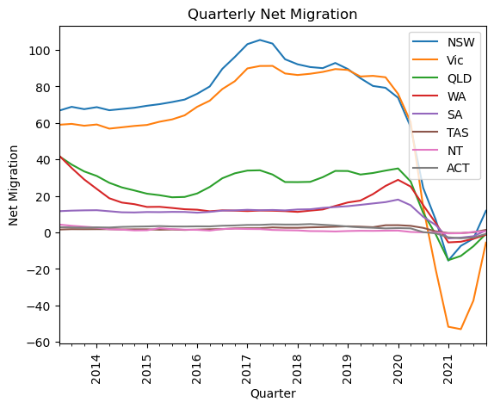

Slide 8
Key findings (cont.)
Q2: the highest and lowest states/territories impacted by housing price between 2013-2021, as reflected in the housing price for the capital citie?
 | Cities | Average | Median | Variance | Standard Deviation | Max | Min | Total Variation (%)
0 | Sydney | 158.91 | 160.5 | 622.74 | 24.95 | 218.7 | 108.7 | 101.20
1 | Melbourne | 138.89 | 142.9 | 434.45 | 20.84 | 185.7 | 102.7 | 80.82
2 | Brisbane | 121.75 | 121.7 | 146.15 | 12.09 | 164.9 | 103.2 | 59.79
3 | Perth | 107.69 | 106.6 | 35.20 | 5.93 | 120.1 | 98.5 | 8.59
4 | Adelaide | 117.82 | 118.7 | 140.69 | 11.86 | 156.3 | 100.9 | 54.91
5 | Hobart | 133.72 | 129.0 | 864.63 | 29.40 | 211.1 | 100.0 | 111.10
6 | Darwin | 100.86 | 100.1 | 94.07 | 9.70 | 114.7 | 86.9 | -8.92
7 | Canberra | 121.25 | 121.5 | 295.36 | 17.19 | 173.5 | 101.0 | 71.78

Slide 9
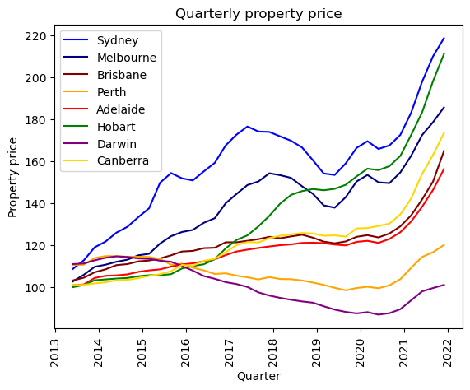

Slide 10
Key findings (cont.)
Q3: Is there a correlation between net overseas migration and housing prices?

Slide 11
Summary and limitation
NSW had the highest number of net migration and northern territory had the lowest number of net migration between June 2013-Dec 2021.
Hobart had the largest increase in housing price and Darwin is the only capital city that had the decrease in housing price between June 2013-Dec 2021.
Limitation:
The study is based on the data available
The outliers are not removed given the number of the observations being small; the results need to be interpreted accordingly.

